Slide 1
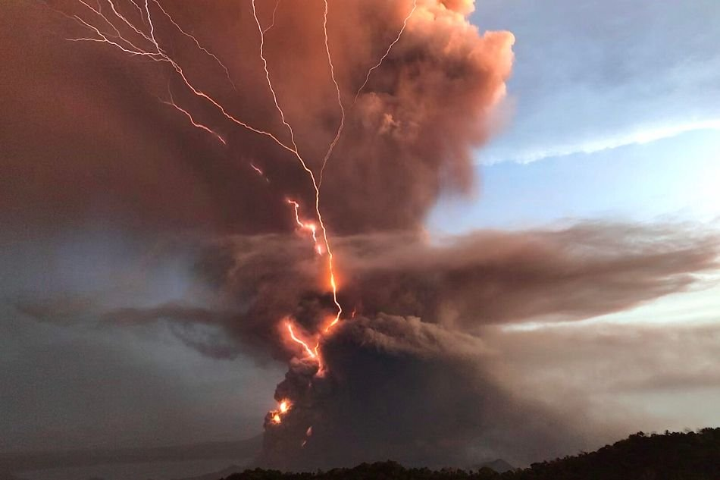
TAAL VOLCANO AND ITS ABRUPT ERUPTION
MARY ISABELLE F. MORENO

Slide 2
HISTORY
Taal Volcano is part of a chain of volcanoes along the island of Luzon, which were formed by two tectonic plates colliding over 500,000 years ago. It is the smallest yet the most active volcano in the Philippines and the world. It is part of the “Pacific Ring of Fire”.

Slide 3
HISTORY
Its unexplained shape and location on an island within a lake within an island, makes it a unique geologic wonder, enthralling thousands of tourists and geologists yearly. Since the formation of this large caldera (Taal Lake), subsequent eruptions created another volcanic island, within Taal Lake, known as Volcano Island. This island covers an area of about 23 kmÂ², and consists of forty-seven different overlapping cones and craters.

Slide 4
How many times did taal explode?

Slide 5
There were 33 (recently 34) recorded phreatic to phreamagmatic eruptions at Taal between 1572 and 1977. A phreatic eruption is a steam-driven explosion accompanied by ash rock and water, while a phreamagmatic one happens when magma interacts with surface or groundwater.
Devastating eruptions were recorded in 1754 and 1911 which destroyed the towns of Lipa, Sala, Tanauan and Talisay.
The September 1965 eruption of Taal ended a dormant period of 54 years, according to the US Geological Survey.

Slide 6
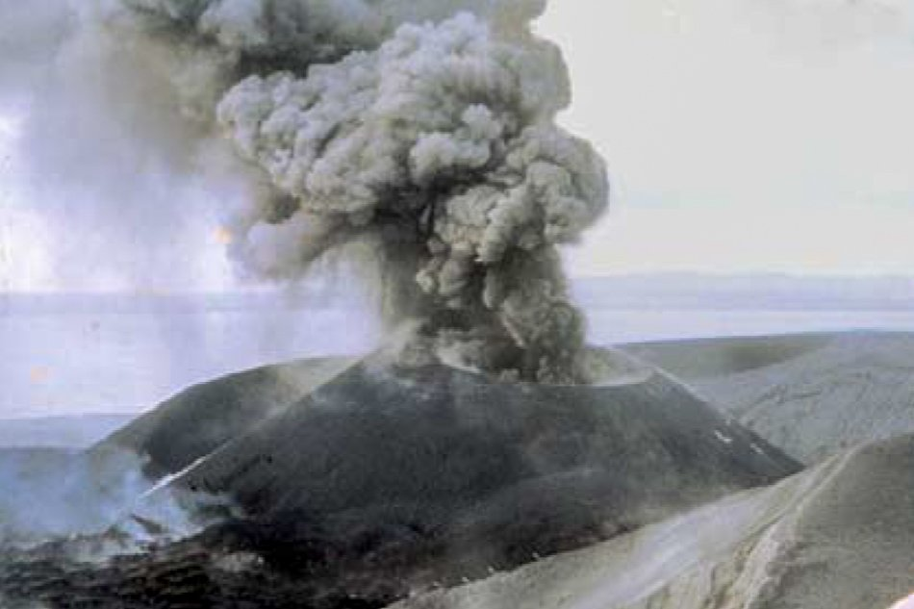
1965
Considered one of its deadliest eruptions recorded, Taal in 1965 saw a pyroclastic explosion, characterized by a turbulent mix of steam, ash and rock that covered the surrounding area and left massive damage, which killed some 200 people.
Eruption at Mount Tabora on The Taal Volcano Island on September 1965 (c) PHILVOCS

Slide 7
Which one is the taal volcano?

Slide 8
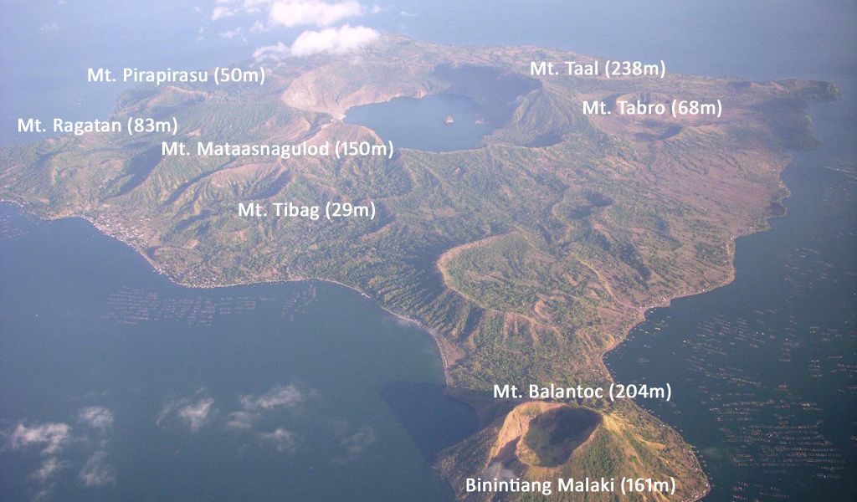
TAAL VOLCANO AT THE RED CIRCLE

Slide 9
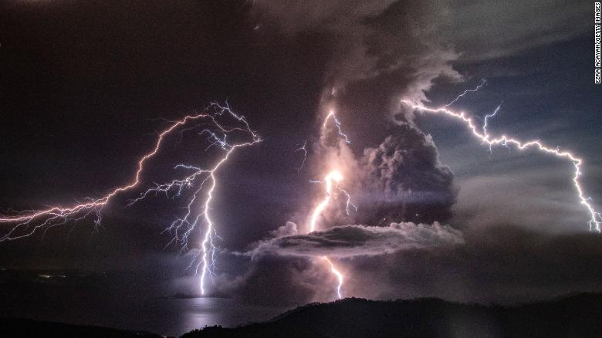
‘EXPLOSIVE ERUPTION OF TAAL VOLCANO'

Slide 10
'What happened?'
On January 12, 2020 (Sunday), the Volcano suddenly spewed ash up and alerted millions of people. It was a sudden occurrence that shocked and scared people. Due to its activity, PHILVOLCS, The Philippine Institute of Volcanology and Seismology (PHIVOLCS) has raised the alert level to four, meaning an "explosive eruption" could happen in the coming hours or days.

Slide 11
What now?
There is no specific date of the explosion but they had recorded a lot of volcano earthquakes, intensity ranging from 1 – 5. Experts said to PREPARE, PRAY and EVACUATE the 17 km danger zone as it is too dangerous to stay there. We can only hope for the safety of the people and their wellbeing.

